Slide 1
FAILED BANKING TRANSACTION ANALYSIS

Slide 2
ABSTRACT
Banking systems deal with massive volumes of transactions every day, where even a small percentage of failures can significantly affect customer trust, operational efficiency, and regulatory compliance. This project presents a scalable, cloud-native solution to automate the detection, cleaning, analysis, and visualization of failed banking transactions using Google Cloud Platform (GCP).
Daily CSV files from multiple branches are uploaded to Google Cloud Storage (GCS). A Dataproc cluster with PySpark processes these files, cleaning and filtering for failed transactions. Filtered data is stored in Cloud SQL (MySQL), and analyzed via BigQuery using federated queries. Visual insight like failure reasons, branch trends, and time-based patterns are built in Looker Studio.

Slide 3
WORKFLOW
STEP1 : Install & Authenticate Google Cloud SDK.
Install the Google Cloud SDK (includes gsutil).Upload raw CSV files to Google Cloud Storage.
STEP2: Data Cleaning with Dataproc
Google Cloud Dataproc is a fully managed service for running Apache Spark and Hadoop clusters. It allows scalable, distributed data processing on cloud infrastructure.For this project, Apache Spark (PySpark) is used within a Dataproc cluster to clean daily banking transaction CSV files. Removes rows where all columns are null and duplicate rows
STEP3: Extract Failed Transactions
After cleaning the raw transaction data, we want to identify and isolate only the failed banking transactions. Monitoring system reliability and analyzing failure trends.In Second PySpark job we filter only the failed transactions and Supports federated querying from BigQuery

Slide 4
workflow
STEP4: Federated Querying with BigQuery
Enable BigQuery to directly query the data stored in Cloud SQL (MySQL) without physically moving the data. This avoids duplication, simplifies data architecture, and allows for near real-time analytics. This is achieved using Federated Queries, which allow BigQuery to connect to external sources such as Cloud SQL using a BigQuery connection.
STEP5: Analysis in BigQuery
BigQuery, as a serverless and highly scalable data warehouse, is ideal for running complex analytical SQL queries on structured datasets. Top failure reasons. Failure trends by branch or city. Hourly patterns of failures
STEP6: Visualization with Looker
The final step in the pipeline is to transform raw data into actionable insights by visualizing it through interactive dashboards. This is done using Looker Studio, a free business intelligence tool from Google that integrates seamlessly with BigQuery.

Slide 5
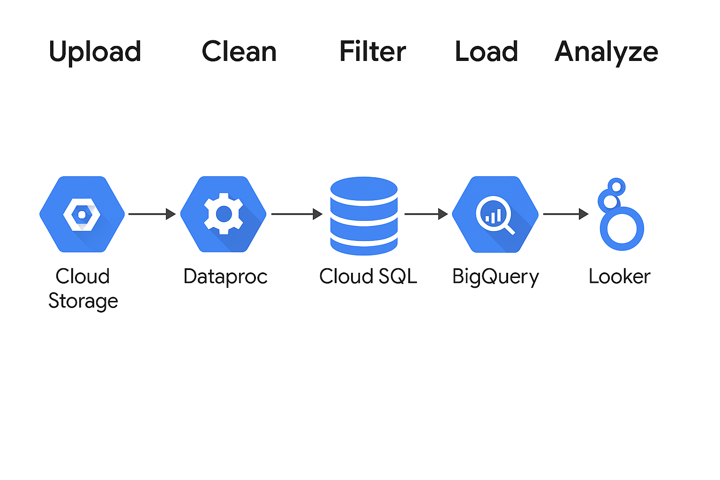
Architecture Diagram

Slide 6
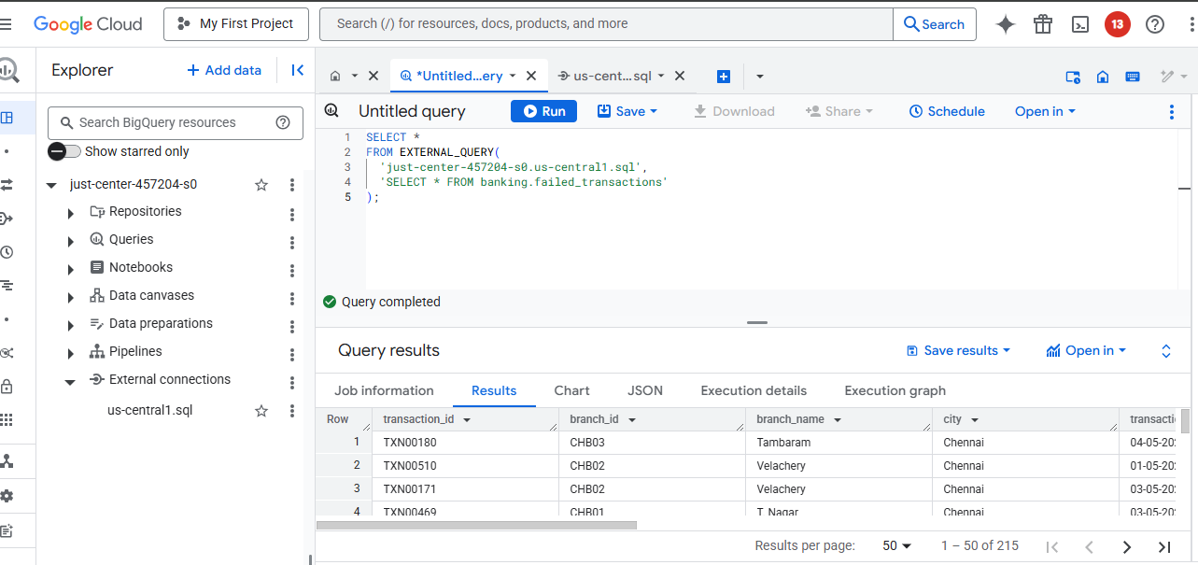
OUTPUT

Slide 7

Thank you

